Slide 1
Mobile EEG - Neurofeedback
18/12/2023

Slide 2
Outline
Considerations
Top 2 (5) mobile EEG headsets
Further options
Excel table

Slide 3
Considerations

Slide 4
Non-negotiables
mobile system (→ wireless)
data quality
max. £ 6,000
covers motor cortex
flexibility (electrode positions)

Slide 5
Technical considerations
n channels
dry vs. saline vs. wet electrodes
active vs. passive electrodes
sfreq
TTL (hardware trigger - time synchronisation)
AUX (photoresistor – time sync) and bipolar channels (EMG)
battery life

Slide 6
Design considerations
setup time
setup difficulty (can patients do it themselves?)
comfort
cap sizes

Slide 7
Top 2 mobile EEG headsets

Slide 8
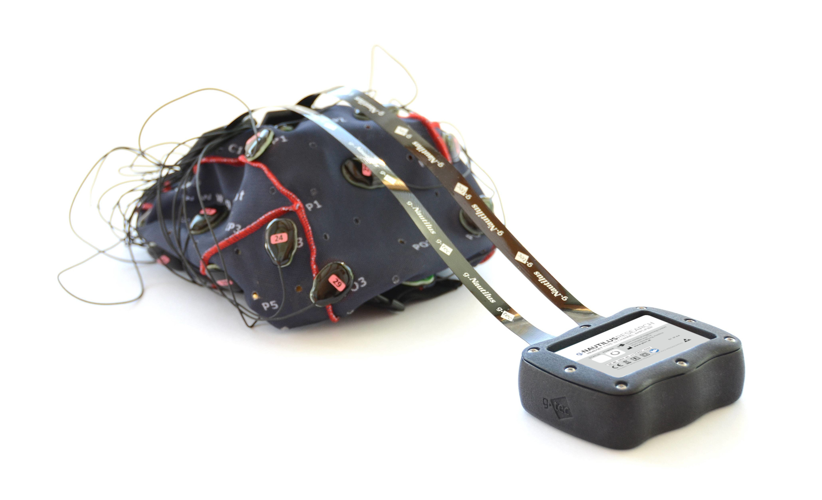
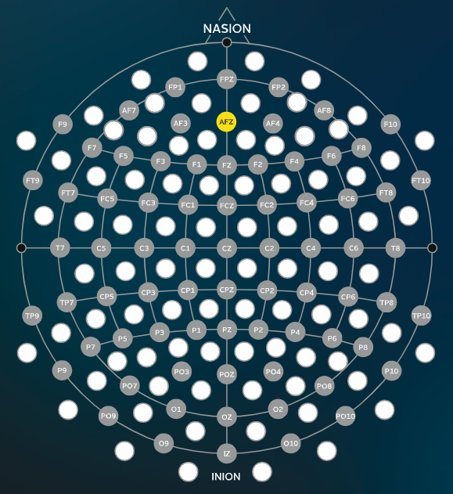
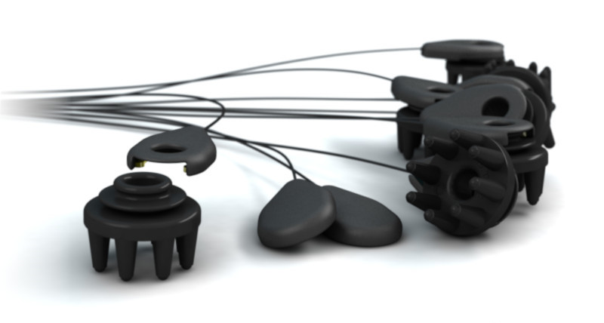
g.Nautilus + g.Sahara Hybrid
Manufacturer: g.tec medical engineering GmbH
Cost: £ 4,850 – 5,400
8 channels - active electrodes – dry or wet (!)
sfreq: 250 or 500 Hz
Layout: 74 position - extended 10/20 system
+ 86 intermediate positions

Slide 9
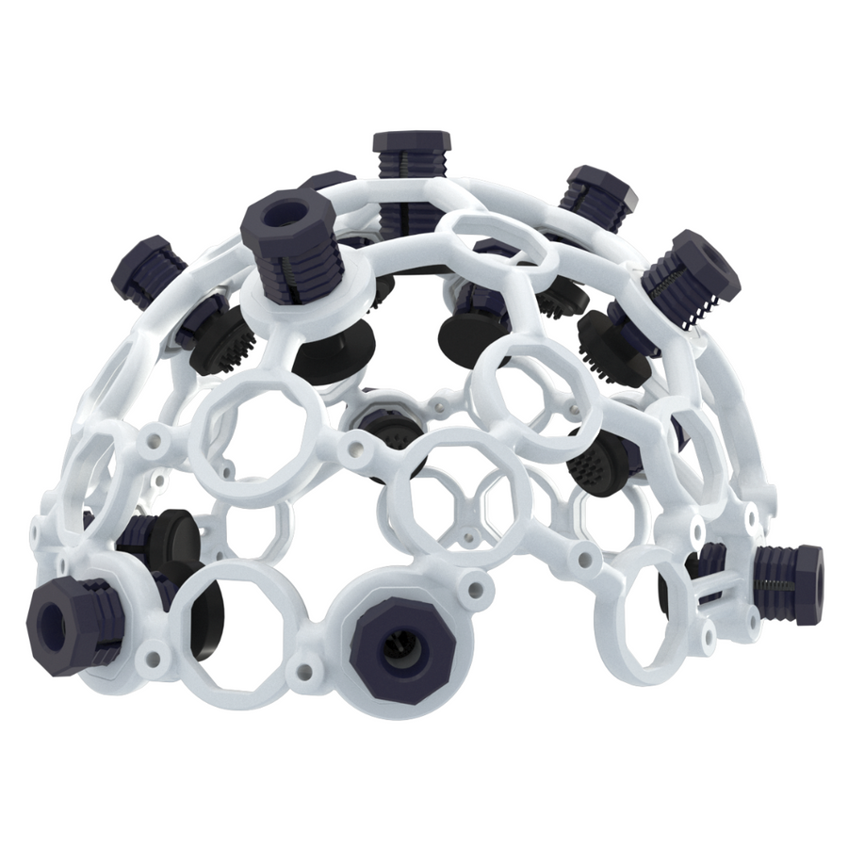
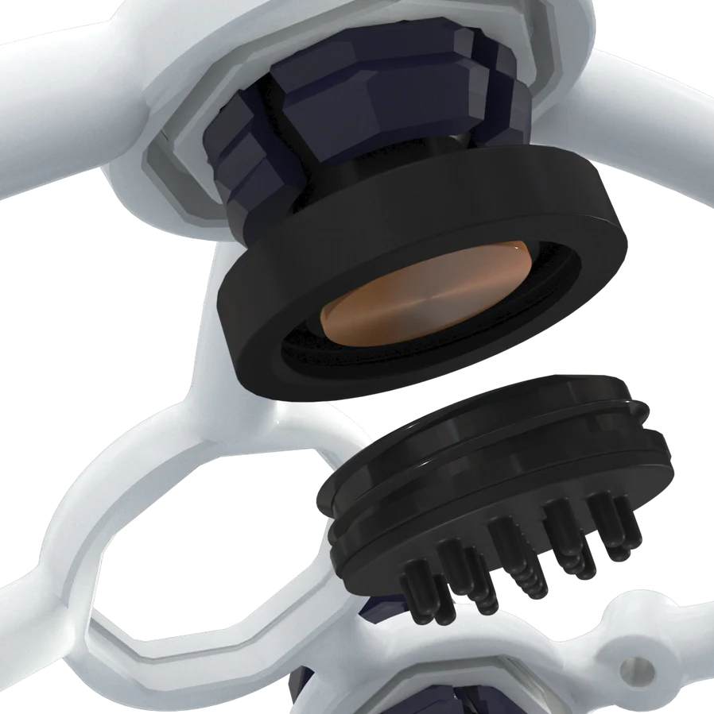
OpenBCI Ultracortex Mark IV
Manufacturer: OpenBCI
Cost: £ 2,750-3,000
16 channels - dry active / wet passive electrodes
sfreq: 125 Hz (1000 Hz)
Layout: flexible but requires CAD + 3D printing

Slide 10
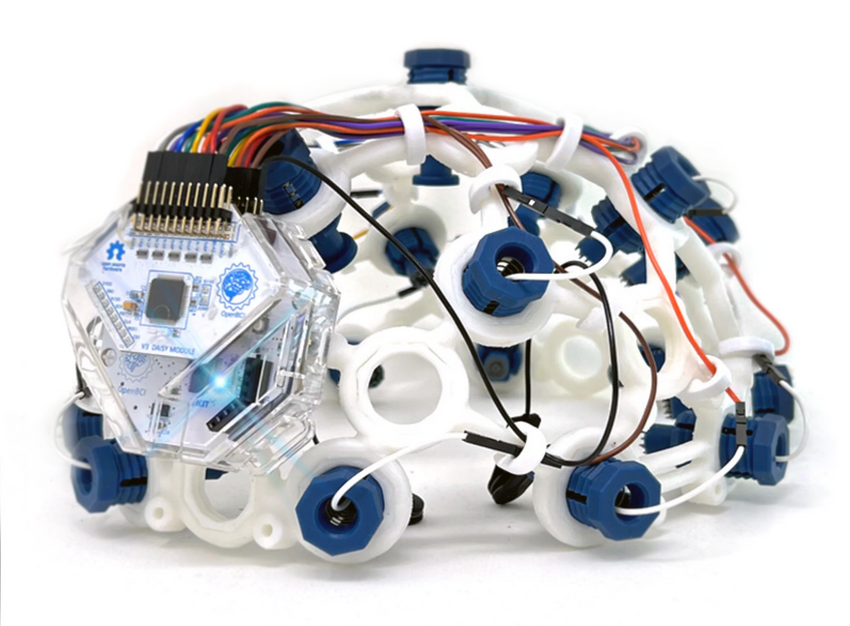
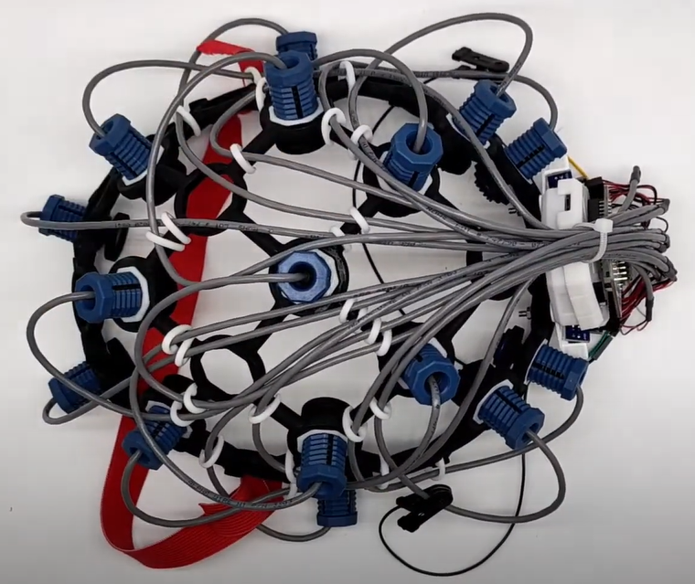
Active EEG Electrode Bundle
Biosensing R&D Bundle
Cost: £ 2,900
wet passive electrodes
no electrical shielding of cables
Cost: £ 3,000
dry active electrodes
electrical shielding of cables

Slide 11
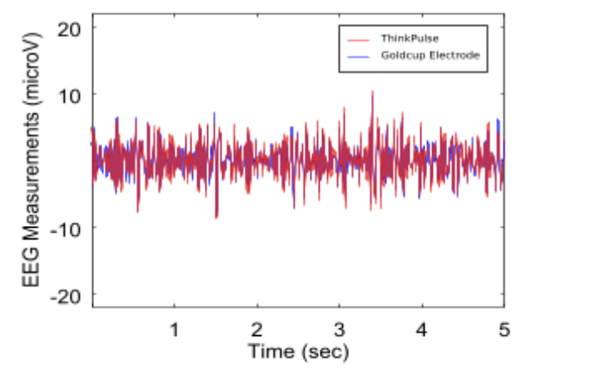
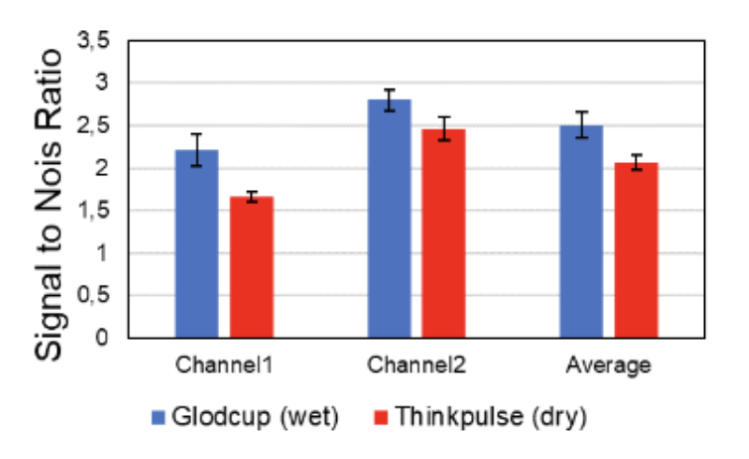
OpenBCI electrodes
ThinkPulse: active dry
Goldcup: passive wet
Sample EEG recording
This EEG Sample shows a comparison between wet passive gold cup electrode (blue curve, used as the reference), and ThinkPulse (red curve) at the same location on occipital O1.
Signals were also compared in spectral readings: they show similar performances. This is made possible thanks to our active electronics, which provides important noise limitation.
Low noise sensor
ThinkPulse active EEG sensor SNR has been compared with respect to a state of the art EEG wet electrode. Each data presented on the histogram (channel 1 & 2) is the result of a 4 measurements average. The “Average” tag is the result of both channel 1 & 2 averaging.
The wet electrodes considered here is a gold-plated one, used with conductive paste for application on the scalp. SNR is given as a power ratio in Alpha-Waves spectral band. It has been measured with respect to Conscious Labs ThinkPulse User Kit.
https://conscious-labs.com/eeg-devices/6-4-channels-eeg-headphones.html

Slide 12
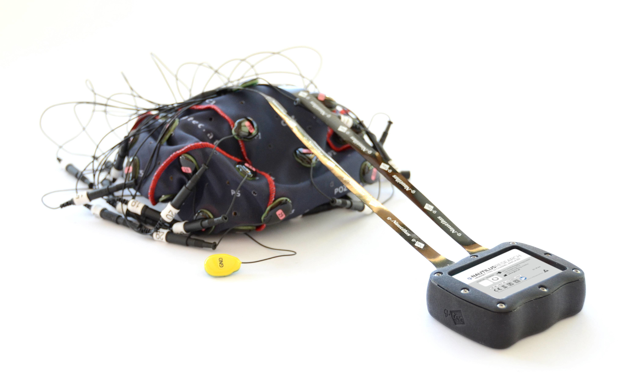
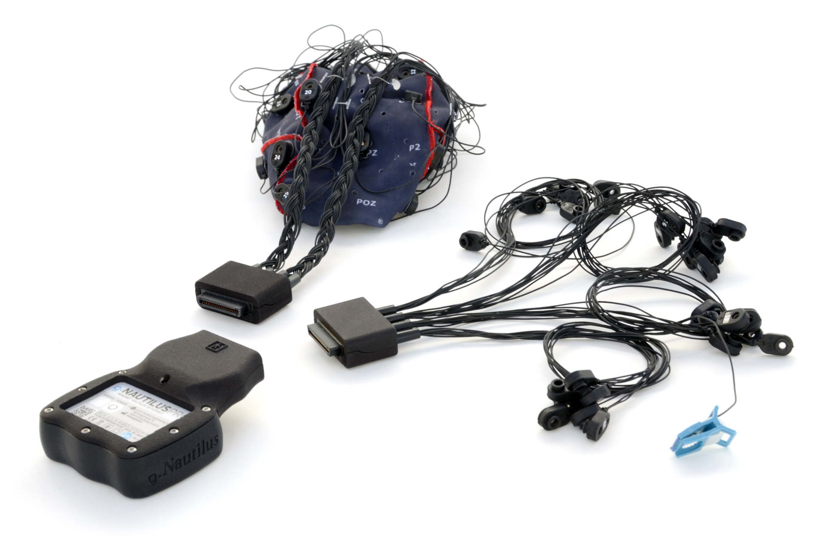
g.Nautilus Research
Cost: £ 4,852
g.Nautilus Multi-Purpose
Cost: £ 4,943
8-4 EEG + 0-4 EMG possible
g.Nautilus Pro Flexible
Cost: £ 5,395
Medical validation
Extensibility: more/other EEG electrodes, EMG

Slide 13
Further mobile EEG headsets

Slide 14
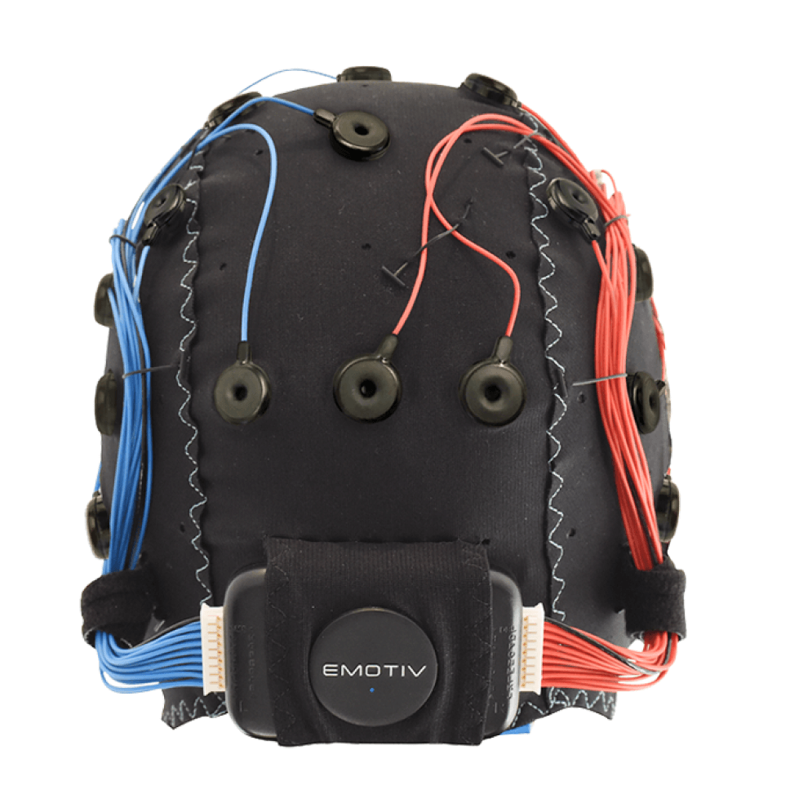
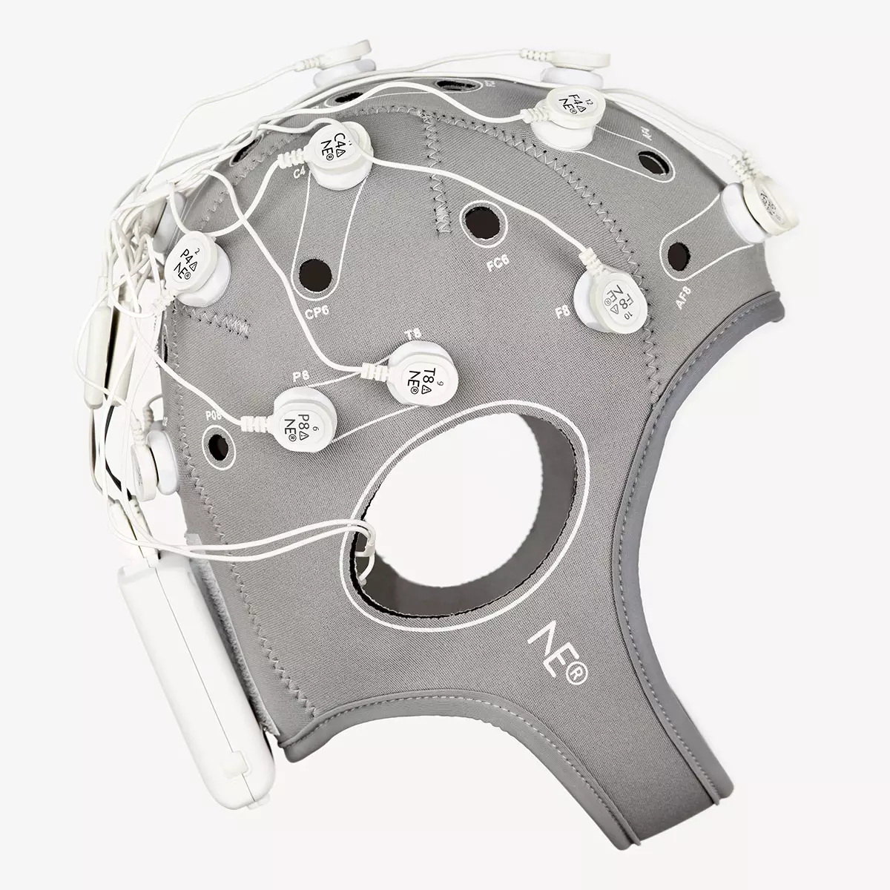
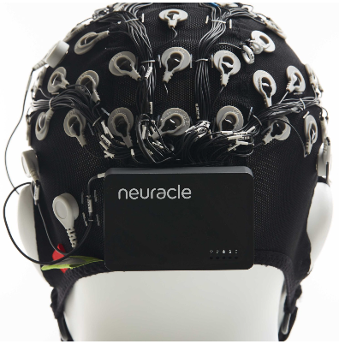
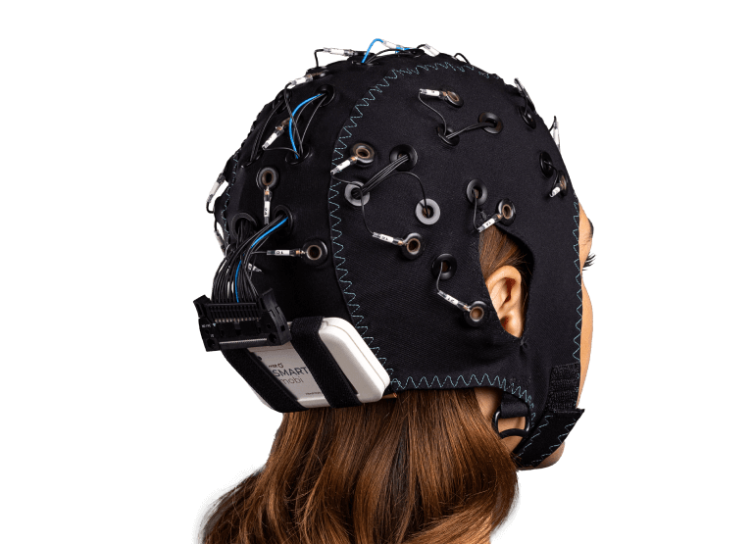
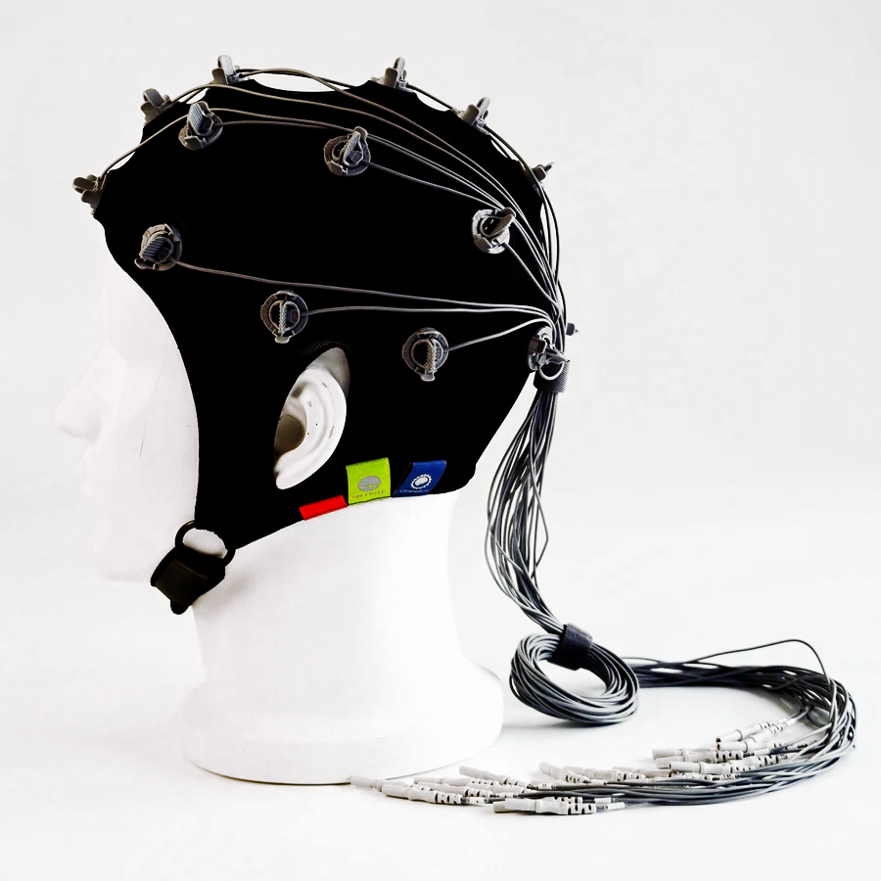

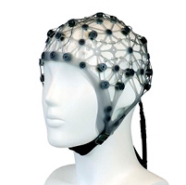
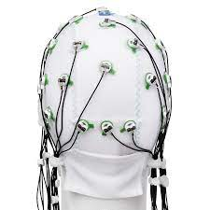
Emotiv: Flex Neuroelectronics: Enobio Wearable Sensing: NeuSen W mBrainTrain: Smarting (PRO)
OpenBCI: gelfree cap Bitbrain: Versatile EEG ANT neuro: waveguard net Brain Products: actiCAP

Slide 15
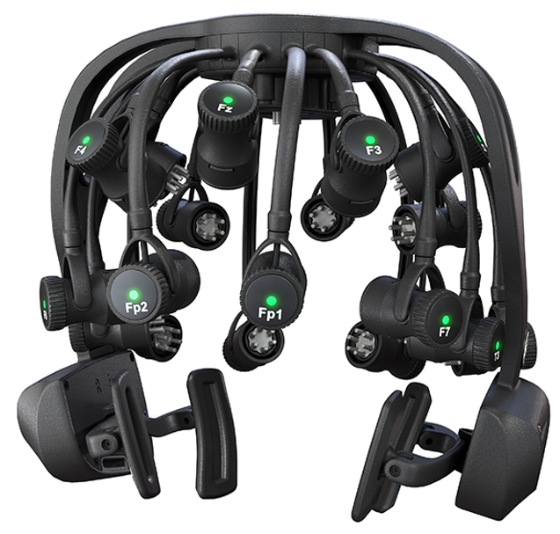
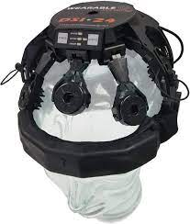
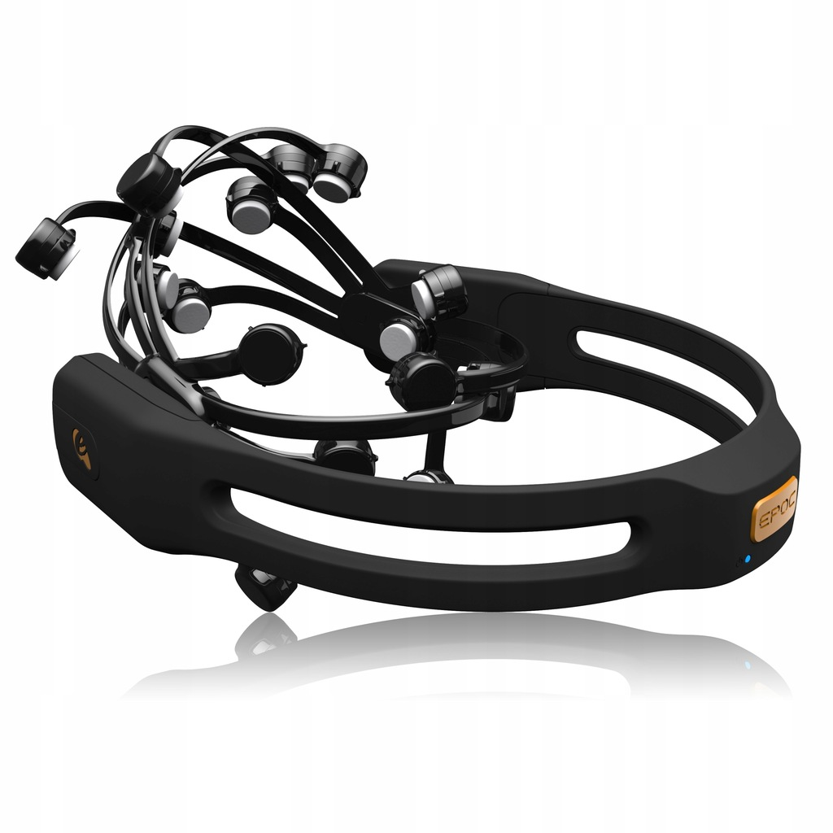

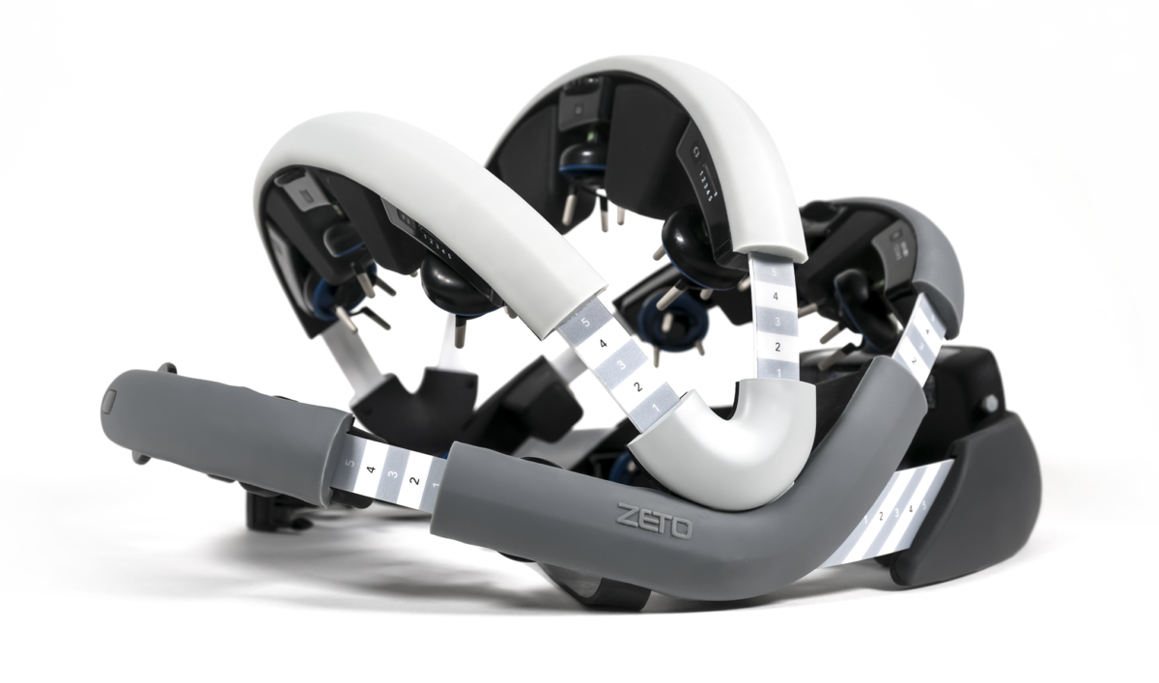
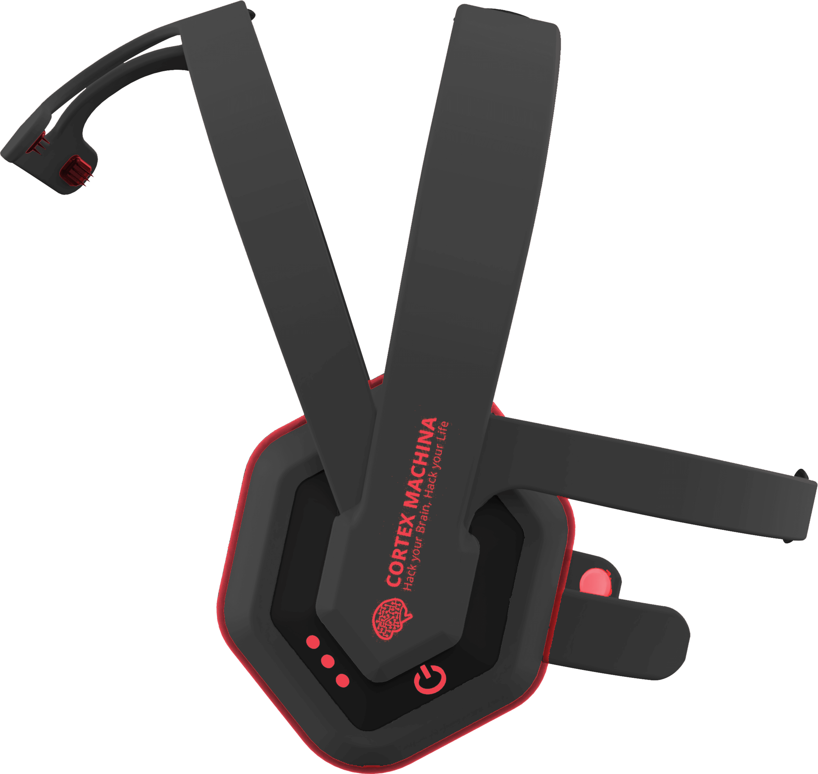
Emotiv: EPOC CGX: Quick-20r v2 Wearable Sensing: DSI-24
Bitbrain: Hero Zeto WR19 Cortex Machina: Vortex or …

Slide 16
Thank you!

